Slide 1


CUSTOMER CHURN ANALYSIS USING SQL
MADE BY KASHISH PUNDIR

Slide 2



DataSet Source: Kaggle
Table Attributes:
  CUSTOMERID
  GENDER
  SENIORCITIZEN
  PARTNER
  DEPENDENTS
  TENURE
  PHONESERVICE
  MULTIPLELINES
  INTERNETSERVICE
  ONLINESECURITY
  ONLINEBACKUP
  DEVICEPROTECTION
  TECHSUPPORT
  STREAMINGTV
  STREAMINGMOVIES
  CONTRACT
  PAPERLESSBILLING
  PAYMENTMETHOD
  MONYHLYCHARGES
  TOTALCHARGES
  CHURN

Slide 3


CHURN ANALYSIS

Slide 4


1. HOW MANY CUSTOMERS HAVE CHURNED VS NOT CHURNED?

Slide 5

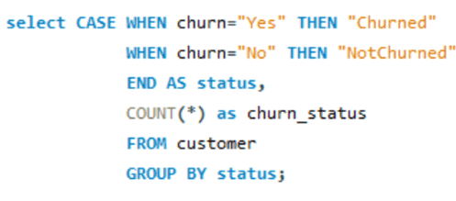


QUERY

Slide 6


2. WHAT IS THE CHURN RATE BY GENDER?

Slide 7
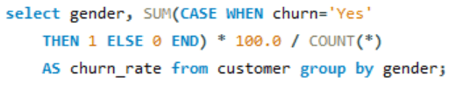
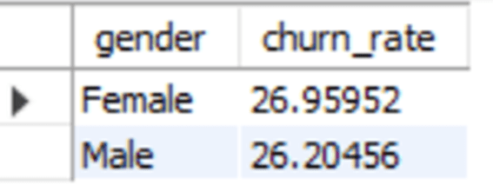
QUERY

Slide 8


3. WHICH CONTRACT TYPE HAS THE HIGHEST CHURN RATE?

Slide 9
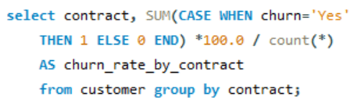
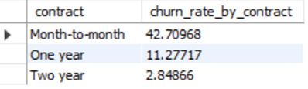
QUERY
This helps HR or analysts know which customer segment is at higher risk of leaving.

Slide 10



4. WHAT IS THE AVERAGE TENURE OF CHURNED VS NON-CHURNED CUSTOMERS?

Slide 11
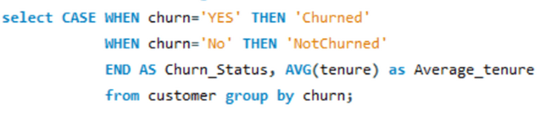
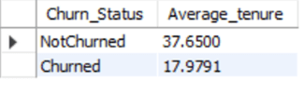
QUERY
Customers are more likely to leave within the first 1.5 years.

Slide 12


💳 PAYMENT & BILLING

Slide 13


1. WHICH PAYMENT METHOD IS MOST USED AMONG CUSTOMERS WHO CHURNED?

Slide 14
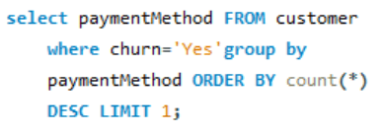

QUERY

Slide 15


2. WHAT IS THE AVERAGE MONTHLY CHARGE FOR CUSTOMERS WHO HAVE CHURNED?

Slide 16
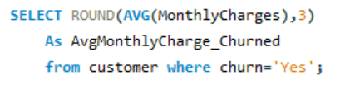

QUERY

Slide 17




👪 DEMOGRAPHIC
ANALYSIS

Slide 18


1. HOW MANY SENIOR CITIZENS ARE USING THE SERVICES?
GOAL
ACTIONS

Slide 19


QUERY

Slide 20


2. DO CUSTOMERS WITH DEPENDENTS CHURN LESS THAN THOSE WITHOUT?

Slide 21
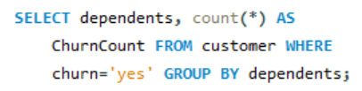
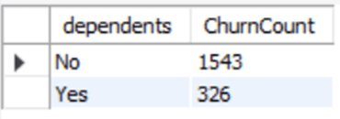
QUERY

Slide 22


3. WHAT IS THE GENDER DISTRIBUTION OF CUSTOMERS WITH A LONG TENURE (E.G., OVER 60 MONTHS)?

Slide 23
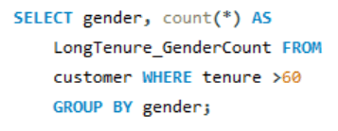
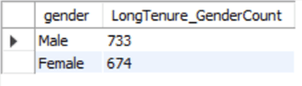
QUERY

Slide 24



📶 SERVICE
UTILIZATION

Slide 25



1. HOW MANY CUSTOMERS HAVE BOTH INTERNET AND PHONE SERVICES?

Slide 26
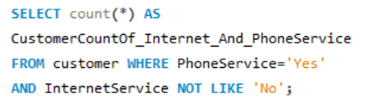
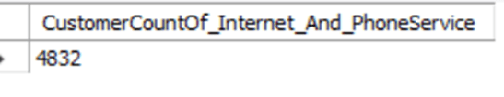
QUERY

Slide 27


2. WHAT PERCENTAGE OF CUSTOMERS HAVE OPTED FOR ALL OPTIONAL SERVICES (ONLINESECURITY, ONLINEBACKUP, DEVICEPROTECTION, TECHSUPPORT)?

Slide 28
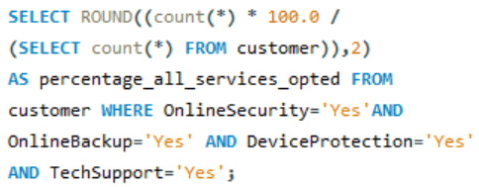
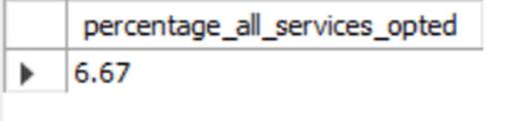
QUERY

Slide 29


OBJECTIVE
3. WHAT IS THE CHURN RATE AMONG CUSTOMERS WITH ‘FIBER OPTIC’ INTERNET VS ‘DSL’?

Slide 30
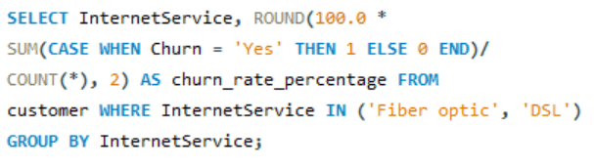

QUERY

Slide 31

THANK YOU

